Slide 1

Challenges faced by company secretaries during lockdown period and corona virus
Registration no -111465862
Submitted by: Chaitali Behera

Slide 2
Cost management
Cost management is a biggest challenge for company secretaries.
Constant struggle to balance company's interest as against interest of other stakeholders.
In the struggle to survive ,companies may be looking for refinancing, reorganising or restricting of group companies or planning.
These planning need to be performed with proper discussion with all members so that to manage the financial liability of the company.

Slide 3
Problems in public companies
Maintaining a registered office and notify company changes of address and changes to the principal place of business within 28 days
For public companies the registered office needs to be open to the public during certain hours
Now due to increase in cases of corona patient shutdowns occurring time to time in many areas , company secretaries are not able to provide valuable service as per public needs

Slide 4
Digitalisation and automation
There is overnight shift of the use of e-signatures is a case in point.
Company secretary across the market have been thrown into finding new ways to obtain signatures and approvals.
Online filling of all legal documents and forms related to company

Slide 5
Problems of digital platforms
Due to lockdown all board meetings are conducted nowadays through online
Due to problem in network connection company secretaries are not acquainted with online application so they could not perform meetings well as compared to offline
So many applications in the market are available which app is safe to use is a problem as company rules should not be stolen by any outsider

Slide 6
Culture and conduct
The current climate demands a very healthy dose of among members just as:
good humour
encouraging executives to communicate with shareholders
understanding the priorities
Focusing on needs
Remain calm

Slide 7
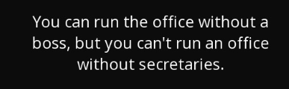
Thanks for watching

